Slide 1

RUNGTA COLLEGE OF DENTAL SCIENCES & RESEARCH
TEATNUS AND GANGRENE
DEPARTMENT OF GENERAL SURGERY

Slide 2
Specific learning Objectives
At the end of this presentation the learner is expected to know ;
Core areas* | Domain ** | Category #
TETANUS | Cognitive | Must Know
GAS GANGRENE | Cognitive | Must Know

Slide 3
Table of Content
ABSCESS
TETANUS
GAS GANGRENE

Slide 4
GAS GANGRENE

Slide 5
GAS GANRENE
It is an acute infective gangrene caused by clostridia organisms. These organism produces gases.If not treated in time, it spread rapidly leading to septicaemia and death This disease mainly affects the skeletal muscles,hence other names are-Clastr. Myonecrosis,clastr.myositis.

Slide 6
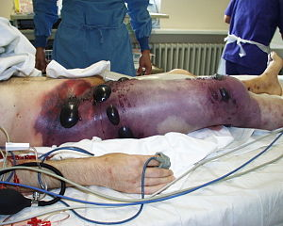

Slide 7
Organisms
Clostridium welchii
Clo.septicum
Clo.histolyticus
Clo.odematiens etc.
These are – Gram +ve
Central spore bearing
Non-motile
Capsulated organism

Slide 8
Toxins produced by organisms
Lecithinase- haemolytic membranolytic and necrotic
Haemolysin- blood destruction
Hyaluronidase- rapid spread of gas gangrene
Protinease- breakdown of proteins & collegen.
Gas produced-hydrogen sulfide AND ammonia

Slide 9
Pathogenesis
Spores enters through wound, during road accident/ crush injury
SPORES GERMINATE
Developed bacteria multiply and releases exotoxins
These exotoxins have multifaceted destructive effect on tissues
Extensive necrosis of muscle with production of gas H₂S and Amonia.
When it affect liver, there is necrosis with frothy blood----FOAMING LIVER is characteristic.
Septicaemia MODS Death

Slide 10
Clinical features:-
Incubation periods- 1-2 days
Local features –
Gross oedema & tenderness
Sutures are under tension
Brownish fluid with odour
Palpable crepitus
Colour changes in muscles
Skin is khakhi coloured due to haemolysis.

Slide 11
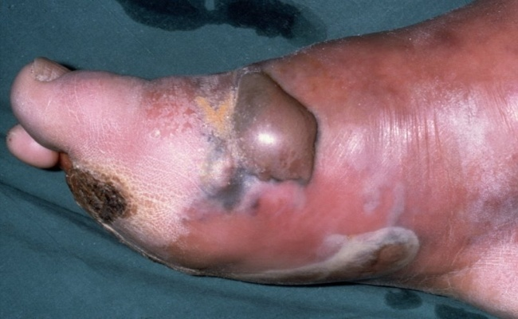

Slide 12
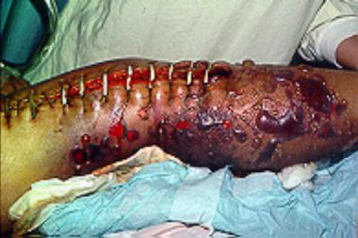

Slide 13
General features-
anxious & alert
toxic and ill
tachycardia with hypotension
Vomitting
fever

Slide 14
Investigation
Routin blood and urine examination
Liver function test.
Blood urea.
Serum creatinine.
X-ray shows gas in muscle plane or under skin.

Slide 15
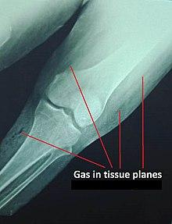

Slide 16
TYPES OF GAS GANGRENE
Clostridial cellulitis- Healthy muscles is not involved.There is feature of cellulitus. It is a mild infection and easily manageable.
Local type:- infection confined to single muscle
Group type:- infection confined to one group of muscle.
Massive type:- gas gangrene involves entire limb.
Fulminant type:- rapid progress leading to toxaemia, renal failure and MODS & often death.

Slide 17
Treatment of a established case
Inj. Benzyl penicillin 20 lakh 4 hourly or
Inj. Metronidazole 500 mg 8 hourly
Fresh blood transfusion
Polyvalent anti-gas gangrene serum, 25000 unit I.V after test dose, repeat after 6 hour
Hyper-baric oxygen
Electrolyte & water management, may require ventilator support

Slide 18
LOCAL TREATMNET OF WOUND
All dead and necrotic tissue are excised and debridement is done until healthy tissue bleeds.Foreign bodies are removed and wound is thoroghly irrigated with savlon etc.
In some cases partial or entire limb amputation may be required to save the life.

Slide 19
PROPHYLAXIS
FOLLOWING MESURES TO BE TAKEN TO PREVENT DEVELOPMENT OF GAS GANGRENE.
Thorough wound care ( debridement).
Precaution during tourniquet application
Precaution during plaster cast application
Use of AGGS in SUSPECTED, contaminated wounds.
THE END

Slide 20
TETANUS

Slide 21
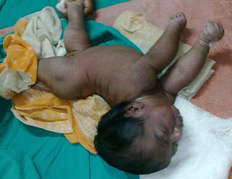
TETANUS
It is an serious infective condition caused by CLOSTRIDIUM TETANY bacteria leading to reflex muscles spasm, often associated with tonic-clonic convulsion.

Slide 22
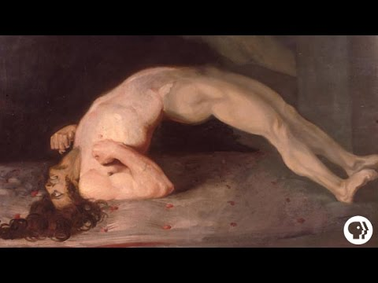

Slide 23
Aetiopathogenesis- Disease is caused by Clostridium Tetani organism.
Gram-positive
Anaerobic
Motile
Noncapsulated
Peritrichous flagella
Terminal spore (drum–stick appearance). Spores are infective and they are found in soil, manure, dust etc.

Slide 24
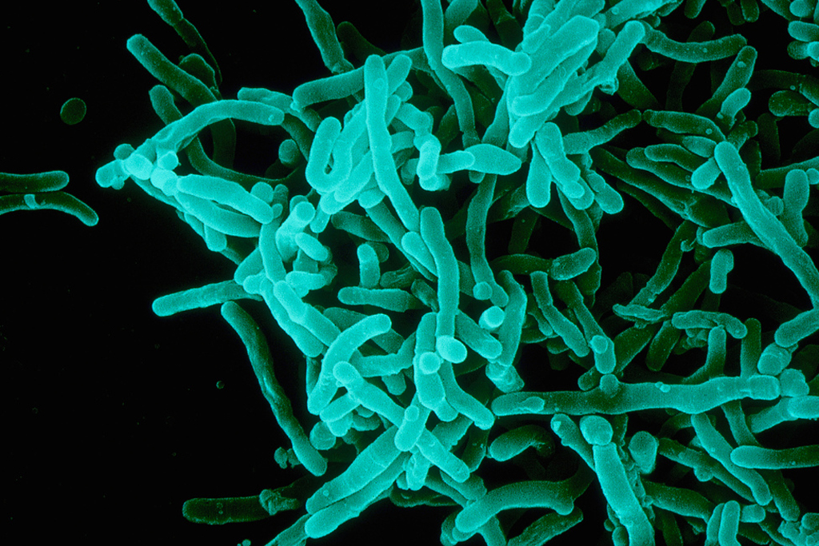
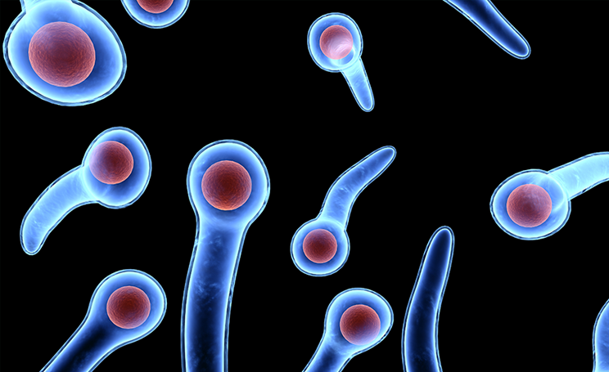

Slide 25
Pathogenesis- the organism produces 2 types of toxins.
1.Tetanospasmin :: It has affinity for nervous tissue. The toxin get fixed to the motor cells of ant. horn cells. It inhibits the release of cholinester ----age enzyme and at spinal level causes reflex spasm of muscles due to any stimuli.
2.Tetanolysin :: (Haemolysin) -It causes the destruction of RBC.
The toxin which is fixed to nervous tissue can not be neutralised, however circulating toxins can be neutralized.
Incubation period-It may vary from few days to months or years. The more important aspect is the time interval between the appearance of first symptom to the muscle spasm. If it is less than 48 hrs, prognosis is poor.

Slide 26
Mode of entry-Any wound contaminated with dust, soil, manure or rusted iron pricks may lead to development of tetanus. so, following means may favour development of tetanus.
minor or major trouma
septic abortion
umbilical sepsis in new born
after surgical operation,specially on gastro-intestinal tract.
NO WOUND, NO TETANUS

Slide 27
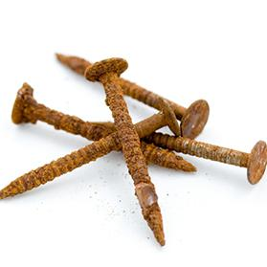
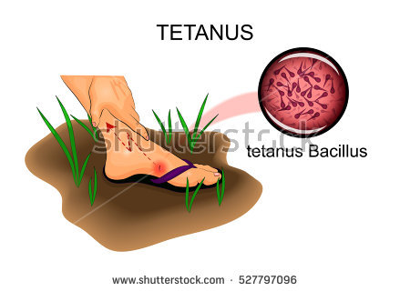

Slide 28
CLINICAL FEATURES
SYMPTOMS-
Stiffness of muscles of jaw(lock jaw) muscles of back and neck.
.Anxiousness and sweating
.Headache,delirium,sleeplessness
.Dysphagia
.Dyspnea.
Tonic seizures involve sudden stiffening and contraction of the muscles. (Clonic seizures involve rhythmic twitching or jerking of one or several muscles.Tonic-clonic seizures are a combination of these two types in a specific pattern and are a type of generalized seizure.)

Slide 29
SIGNS.-
Trismus
Risus Sardonicus
Neck rigidity
Spasm and rigidity of all muscles
Hyperflexia
Tonic-clonic convulsions
Retention of urine due to spasm
Symptoms will be aggravated by stimuli (light, noise etc.)
Opisthotonus, Orthotonus, Emprosthotonus, Pleurosthotonus
D/D
Strychnine poisoning
Trismus due other local reason
Hydrophobia
Epilepsy

Slide 30
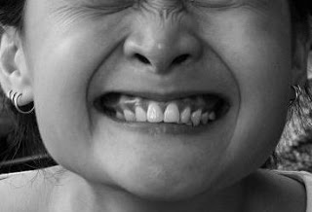
Risus sardonicus

Slide 31

Tetanus lockjaw

Slide 32
Various terms used to describe different tetanic
affection:
1. Tetanus neonetorum
2. Bulbar tetanus ( highly fatal)
3. Latent tetanus (disease develops many month after injury)
4. Local tetanus
5. Cephalic tetanus
6. Peurperal tetanus
7. Post operative tetanus
8. Otitis tetanus

Slide 33
Staging of Tetanus
1.Mild tetanus-
* only tonic rigidity without spasm or
dysphagia.
2.Serious ill-
* patient is having dysphagia and reflex
spasm.
3.Dangerously ill-
* Patient is having in addition to above,
major cynotic convulsions

Slide 34
INVESTIGATION
1. All relevent tests to rule out the diseases
shown in differential diagnosis(D/D).
2.Culture media for Cl.Tetany are- RCM media
or in Nutrient Agar

Slide 35
TREATMENT
A) General treatment
B) Specific treatment
C) Prophylaxis

Slide 36
GENERAL TREATMENT
1. Admission in isolation unit in hospital.
2. Avoid noise and lights in the room.
3. Care of wound-
4. Anti-tetanus serum (now, rarely used.)After test dose,50,000 units IM and 50,000 units IV is given.
5. Anti-tetanus globulin(ATG) it is preferred choice. It is given 3000-4000 units IM. No test is required.
6. Inj. crystalline penicillin 10 lakh unit, every 6hrly for 7-10 days is the drug of choice.
7. Metronidazole 500mg IV every 8hrly is good option.
8. Good nursing care- Care of urinary blader, bed sore, Ryles tube feeding and care to prevent injury during spasm .

Slide 37
SPECIFIC MANAGEMENT
Mild cases -
1. Heavy sedation-using cocktail drugs to relieve spasm and convulsion.
1.Chlorpromazine 50-100 mg ,every 6hrly.
2.Phenobarbitone 30-60 mg ,every 6hrly
3.Diazepam 10-20 mg ,every 6hrly.
These drugs are used in such a way that patient receive one or the other drug every 2hrly.
2. Inj.diazepam 10mg,Tracheostomy set, Laryngoscope, endotrachel tube etc are kept in the room to tackle emergency.

Slide 38
SERIOUSLY ILL—Dysphagia and respiratory problems are marked.
Nasogastric tube for feeding and if nessesory, tracheostomy are done along with sedation.
DANGEROUSLY ILL - Patient having Cyanotic convulsions, they require heavy sedation along with drug induced muscles paralysis and patient is put on positive pressure ventilation.
******

Slide 39
PROPHYLAXIS
1.Immunisation to mother during pregnancy.
2.Primary and booster doses of DPT to infant and children.
3.After injury to indidual,if he has not received booster dose in last 5 yrs,one shot of TETANUS toxoid is to be given.
4.Proper debridement and care of wound.
5.In contaminated and suspected wound,250 units of ATG to be given around the wound.
CAUSE OF DEATH
1.aspiration pneumonia
2.Laryngeal spasm-respiratory arrest,cardiac arrest.

Slide 40
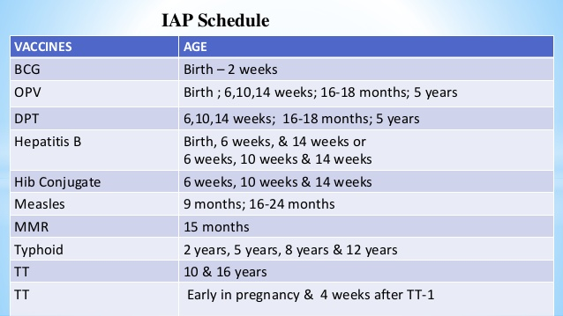

Slide 41
REFERENCES
SRBS BOOK OF GENERAL SURGERY
A MANUAL ON CLINICAL SURGERY - S DAS
MANIPAL MANUAL OF SURGERY - K RAJGOPAL SHENOY
BAILEY AND LOVES SHORT PRACTICE OF SURGERY

Slide 42
Question & Answer Session
You may ask your doubts related to the topic?

Slide 43
THANK YOU

